Slide 1
Decision making or conditional statements
- A.Raishabanu AP/IT

Slide 2
Definition
Conditional statements are decision-making statements.
They execute different blocks of code depending on whether a condition is true or false.

Slide 3
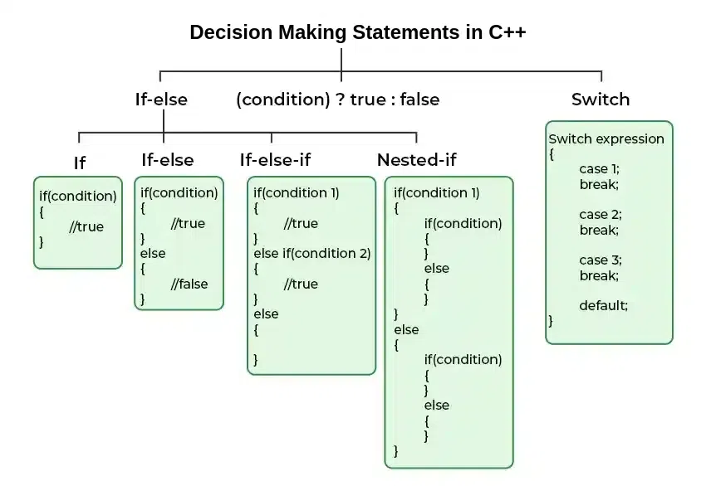
Types of conditional Statement

Slide 4
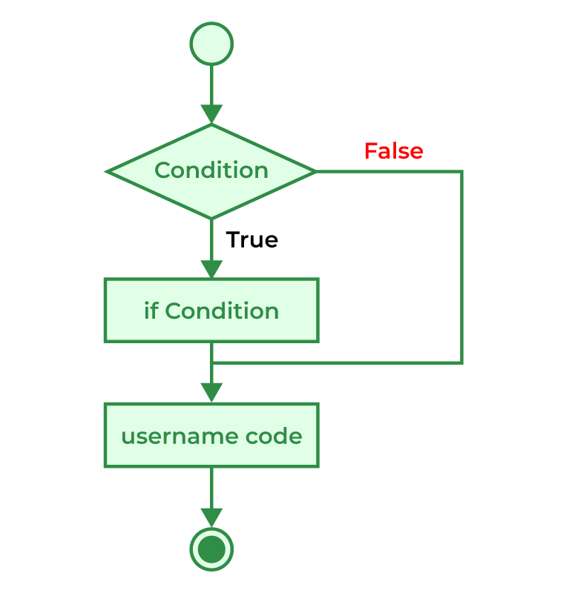
Simple if
Used when only the true condition needs to be executed.

Slide 5
Syntax
if (condition)
{ // Code to execute if condition is true
}

Slide 6
Example – Eligible to vote
#include<iostream>
using namespace std;
int main()
{
int age = 20;
if(age >= 18)
{
cout << "Eligible to vote";
}
return 0;
}

Slide 7
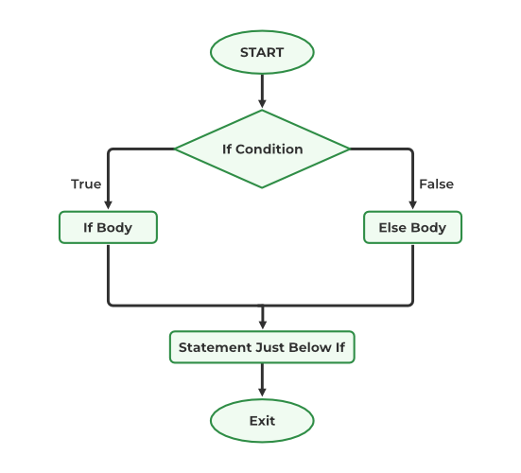
If- else statement
Executes if block if the condition is true, otherwise executes else block.

Slide 8
Syntax
if (condition)
{
// Code to execute if condition is true
}
Else
{
// Code to execute if conditions are false
}

Slide 9
Example – pass or fail
#include<iostream>
using namespace std;
int main()
{
int mark = 40;
if(mark >= 50)
{
cout << "Pass";
}
else
{
cout << "Fail";
}
return 0;
}

Slide 10
Else-if ladder
The else-if ladder is a decision-making statement used to test multiple conditions.
Conditions are checked from top to bottom.
When a condition is true, its corresponding block of code is executed.
The remaining conditions are not checked after a match is found.
If none of the conditions are true, the else block is executed.
It is useful when selecting one option from multiple alternatives.

Slide 11
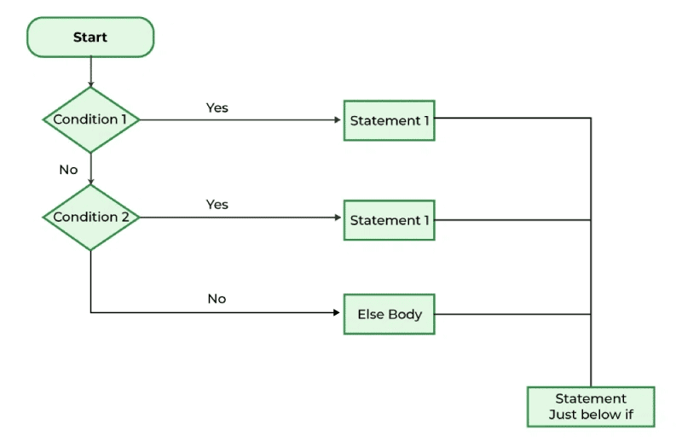
Flow chart else- if ladder

Slide 12
Syntax
if (condition1)
{
// Code executes if condition1 is true
}
else if (condition2)
{
// Code executes if condition1 is false AND condition2 is true
}
else if (condition3)
{
// Code executes if previous conditions are false AND condition3 is true
} ...
else
{
// Optional fallback code executes if ALL conditions are false
}

Slide 13
Example
#include<iostream>
using namespace std;
int main()
{
int mark = 82;
if(mark >= 90)
{
cout << "Grade A";
}
else if(mark >= 75)
{
cout << "Grade B";
}
else if(mark >= 50)
{
cout << "Grade C";
}
else
{
cout << "Fail";
}
return 0;
}

Slide 14
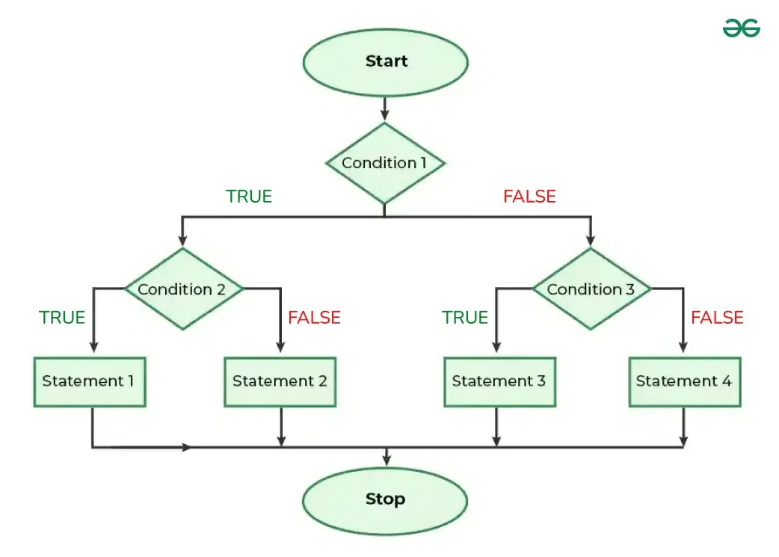
Nested if else
If statement is inside another if or else statement

Slide 15
Syntax
if(condition1) {
if(condition2) {
// Statement 1
}
else {
// Statement 2
}
}
else {
if(condition3) {
// Statement 3
}
else {
// Statement 4
}
}

Slide 16
#include <iostream>
using namespace std;
int main()
{
int age;
char license;
cout << "Enter Age: ";
cin >> age;
cout << "Do you have a driving license? (Y/N): ";
cin >> license;
if(age >= 18)
{
if(license == 'Y' || license == 'y’){
cout << "Eligible to drive."; }
else {
cout << "Not eligible to drive. Driving license required.";
} }
else
{
cout << "Not eligible to drive. Age must be 18 or above.";
}
return 0;
}

Slide 17
Switch case
The switch statement is a multi-way decision-making statement.
It is used to select one block of code from multiple alternatives.
The value of an expression is compared with the values of different case labels.
When a matching case is found, the corresponding statements are executed.
The break statement is used to terminate the switch block and prevent fall-through.
If no case matches, the default block is executed (optional).

Slide 18
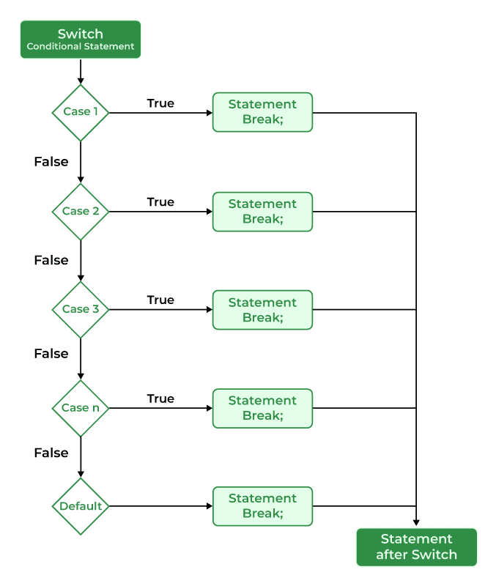

Slide 19
Syntax
switch (expression)
{
case value1:
// Code to execute if expression == value1 break;
case value2:
// Code to execute if expression == value2 break;
default:
// Code to execute if no cases match
break;
}

Slide 20
#include <iostream>
using namespace std;
int main()
{
int day;
cout << "Enter a number (1-3): ";
cin >> day;
switch(day)
{
case 1:
cout << "Monday";
break;
case 2:
cout << "Tuesday";
break;
case 3:
cout << "Wednesday";
break;
default:
cout << "Invalid Day";
}
return 0;
}

Slide 21
Conditional operator
Refer operator ppt

Slide 22
Important 3 marks
Define the if statement.
What is an if-else statement?
Define a nested if.
What is an else-if ladder?
Define the switch statement.
What is the purpose of the break statement in a switch?
What is the default case in a switch statement?
What is the conditional (ternary) operator?
Write the syntax of the switch statement.
State one difference between if-else and switch.

Slide 23
12- marks
Explain the different types of conditional statements in C++ with suitable examples.
Explain the if-else statement with syntax, flowchart, and example.
Explain the nested if-else statement with a suitable example.
Describe the else-if ladder with syntax and example.
Explain the switch statement with syntax, example, and advantages.
Compare if-else and switch statements with suitable examples.
Explain the conditional (ternary) operator with syntax and example.

Slide 24
Programs
Check whether a number is positive, negative, or zero.
Check whether a number is even or odd.
Find the largest of two numbers.
Find the largest of three numbers.
Check whether a person is eligible to vote.
Medium Programs
Find the grade of a student using the else-if ladder.
Display the day of the week using the switch statement.
Create a simple calculator using the switch statement.
Check whether a year is a leap year.
Find whether a character is a vowel or consonant using switch.
Slightly Advanced Programs
Check whether a character is uppercase, lowercase, digit, or special character.
Find the greatest among four numbers using nested if.
Calculate an electricity bill using the else-if ladder.
Calculate income tax based on income slabs using the else-if ladder.
Create a menu-driven program (Addition, Subtraction, Multiplication, Division) using the switch statement.

